Slide 1
MOAHY
Restaurant
Presented to :
Dr. Manar & Eng. Esraa
Presented by:
Mohamed Hossam - Mariam Moustafa - Omar Ahmed – Abeer Hesham – Hasna Amer - Yara Ahmed

Slide 2
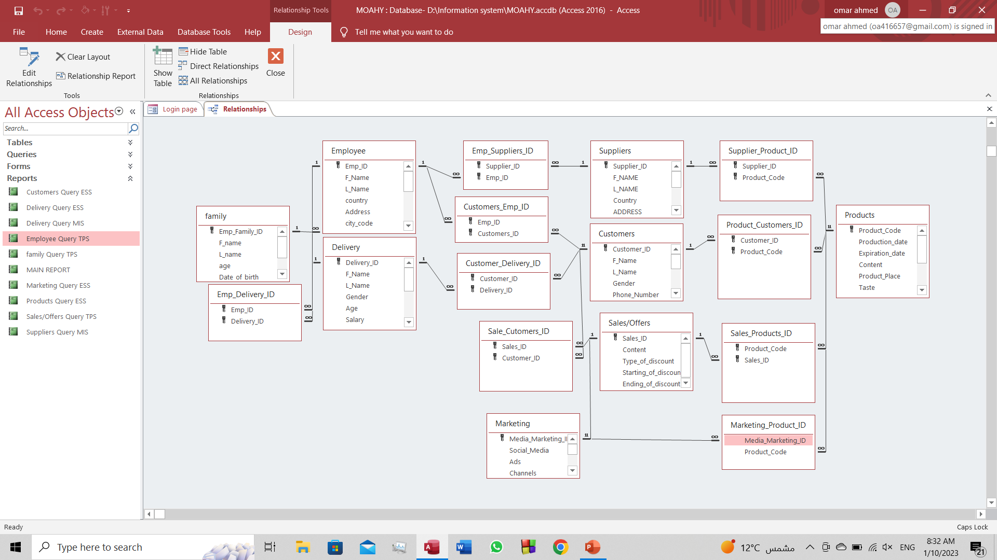
ENTITY RELATIONSHIP DIAGRAM

Slide 3
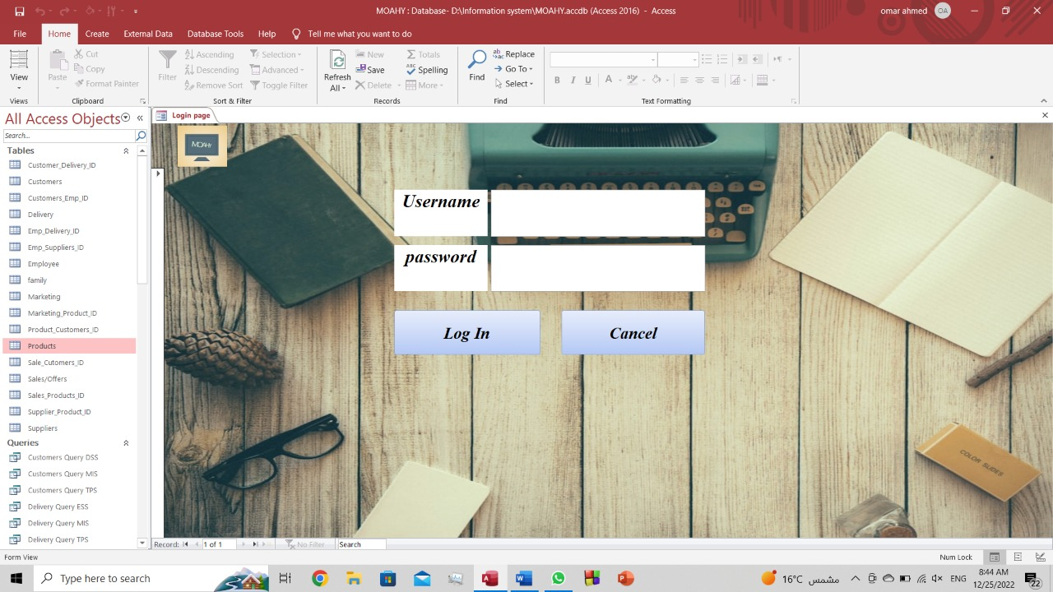
LOGIN PAGE

Slide 4
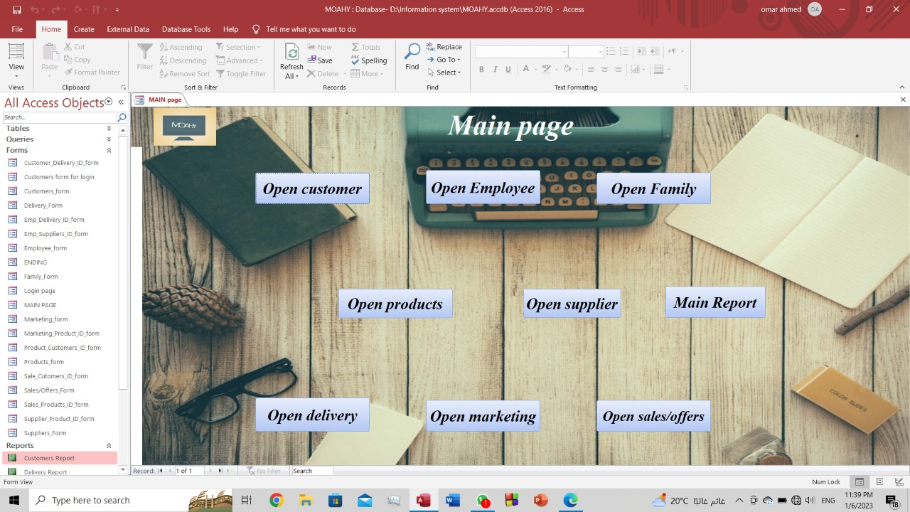
MAIN PAGE

Slide 5
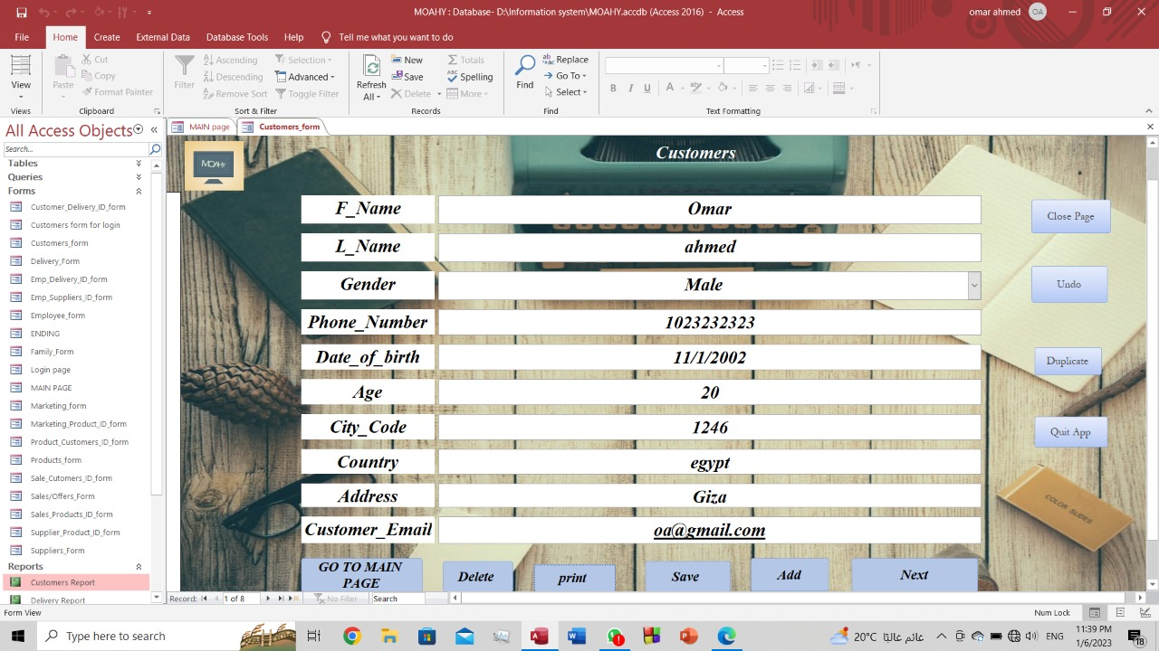
CUSTOMER FORM

Slide 6
MAIN PAGE

Slide 7
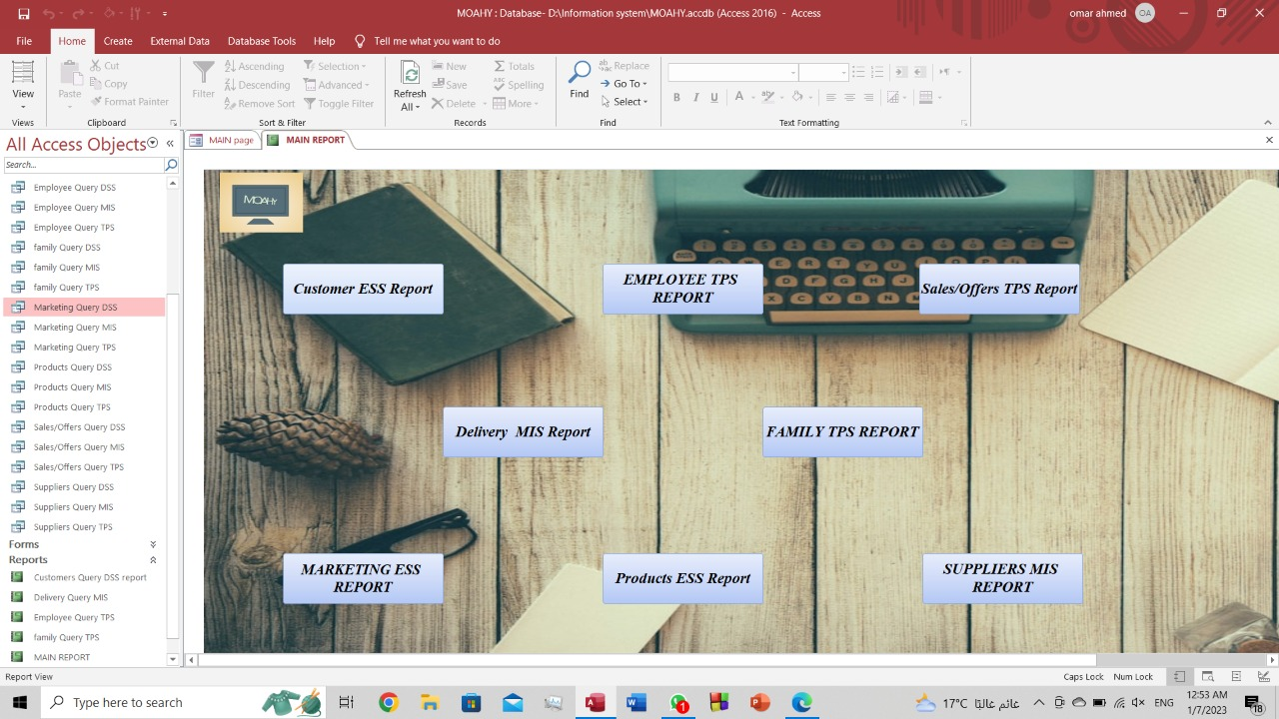
MAIN REPORT

Slide 8
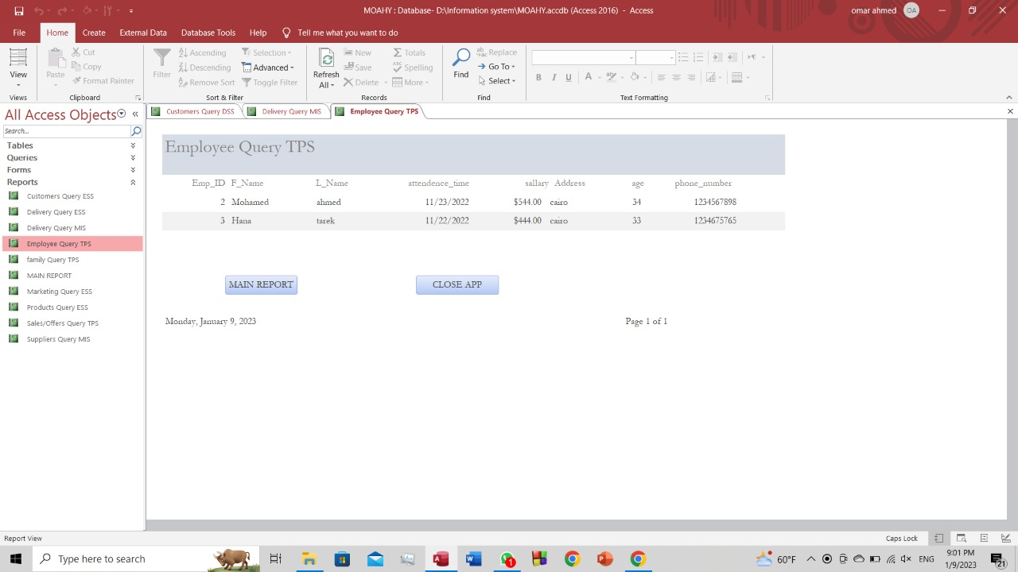
Employee query report (TPS)
Transaction processing system is all the daily transactions and operations within the restaurant

Slide 9
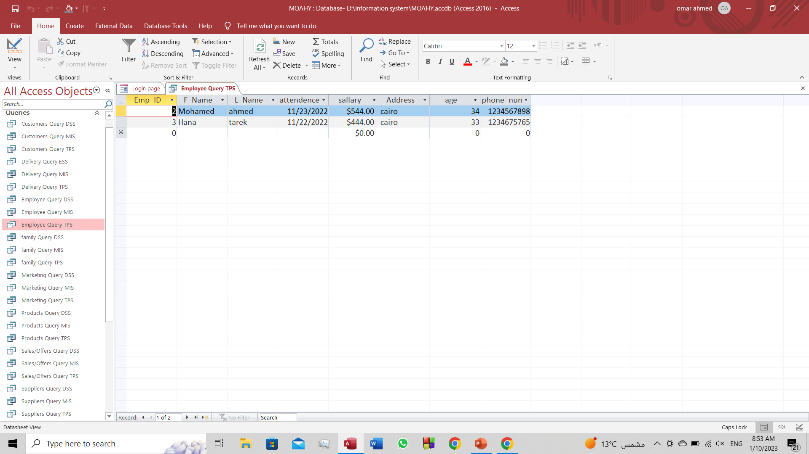
EMPLOYEE QUERY TPS

Slide 10
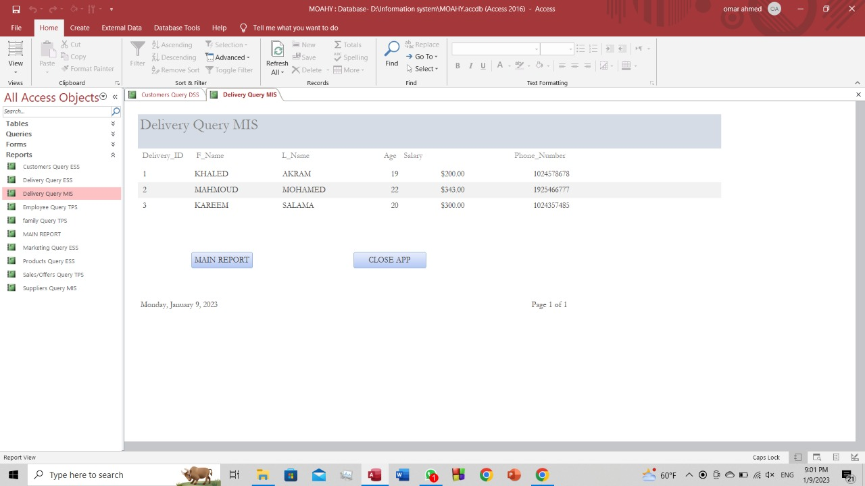
Delivery query report (MIS)
Management information system is data that will help managers make decisions

Slide 11
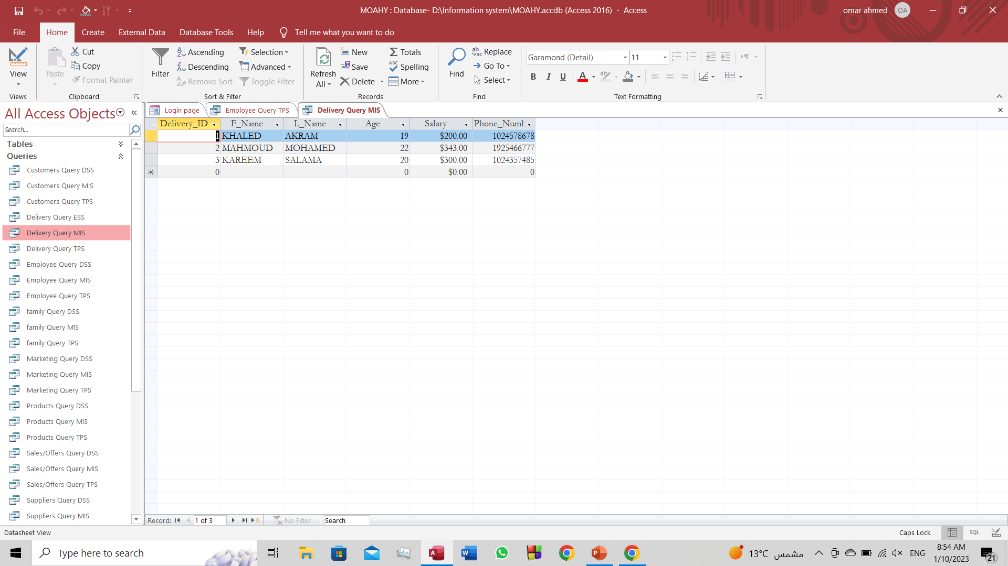
DELIVERY QUERY MIS

Slide 12
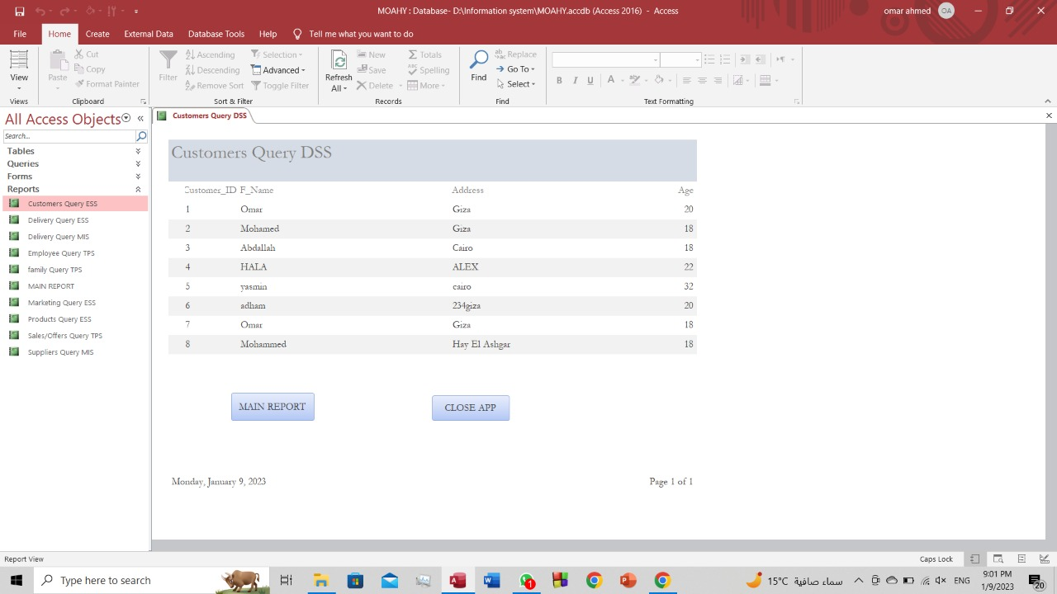
Customer query report (ESS)
Executive supporting systems a type of management support system that facilitates and supports senior executive information and decision-making needs.

Slide 13
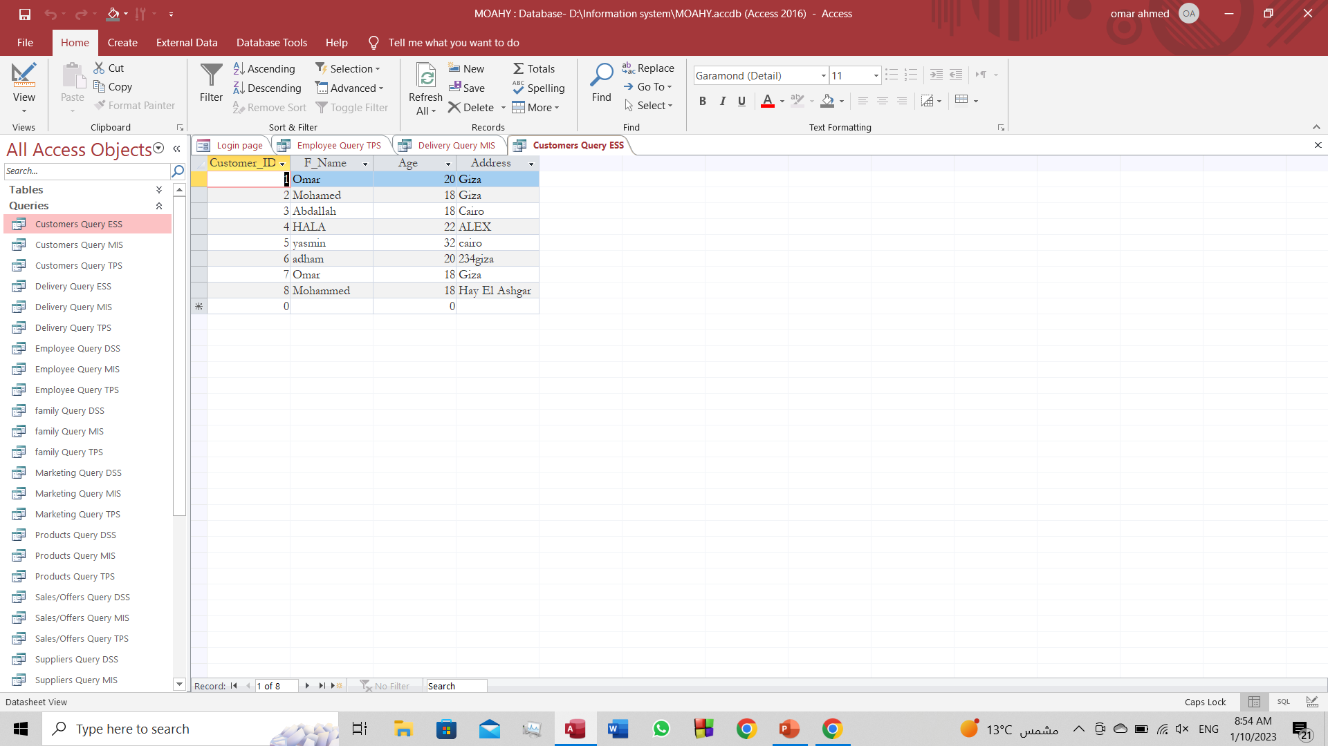
CUSTOMER QUERY ESS

Slide 14

Photoshop logo

Slide 15


Brochure + Website
SCAN THE QR CODE TO OPEN THE WEBSITE

Slide 16
Thank You!

